Slide 1


Slide 2

Engagement with young people and their mental health during the COVID-19 pandemic

Slide 3


Healthwatch Richmond & Kingston
Sara Rossi
Projects and Outreach Officer

Slide 4

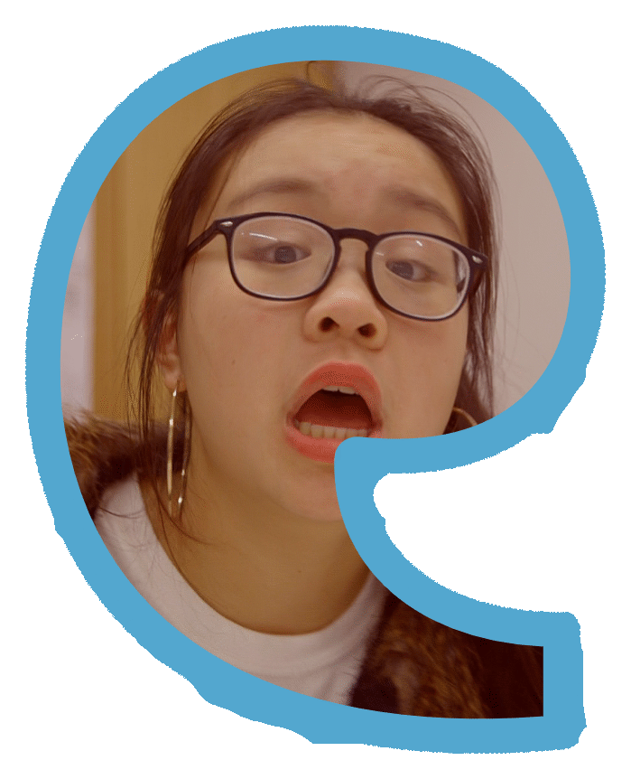
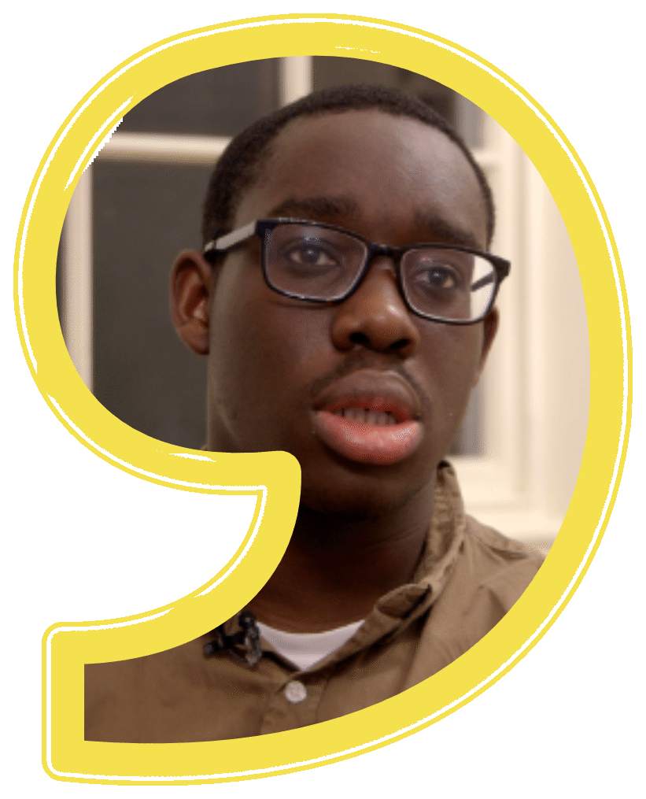
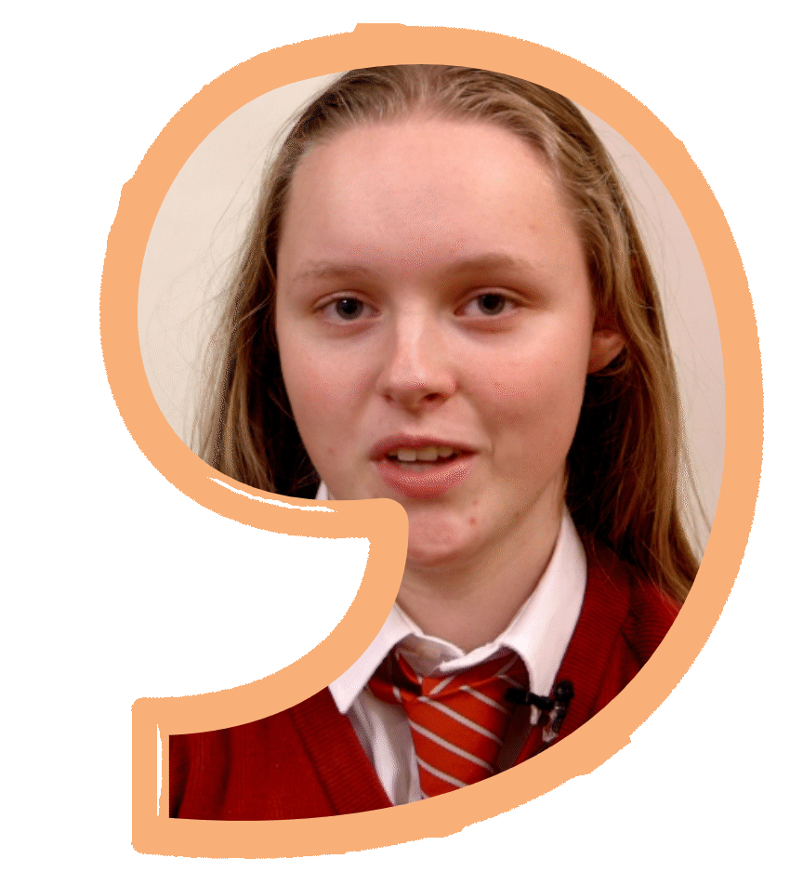

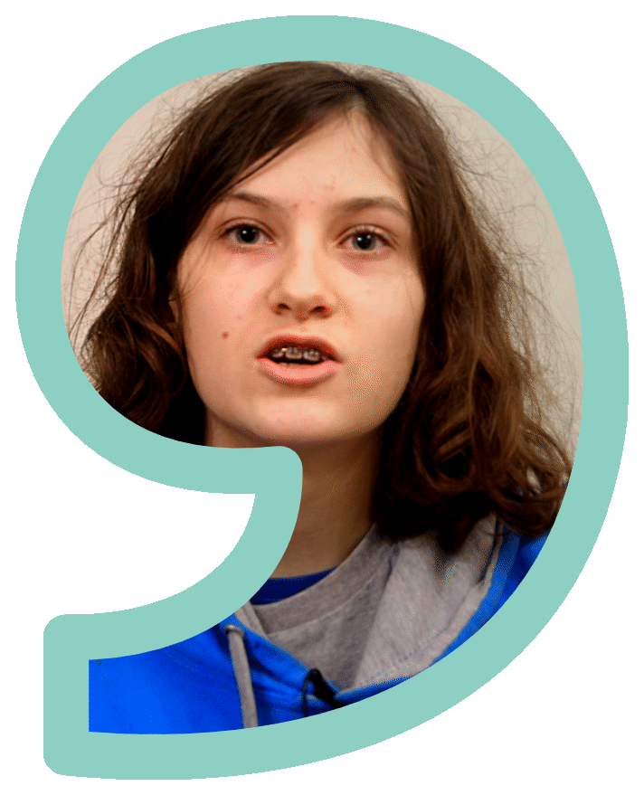
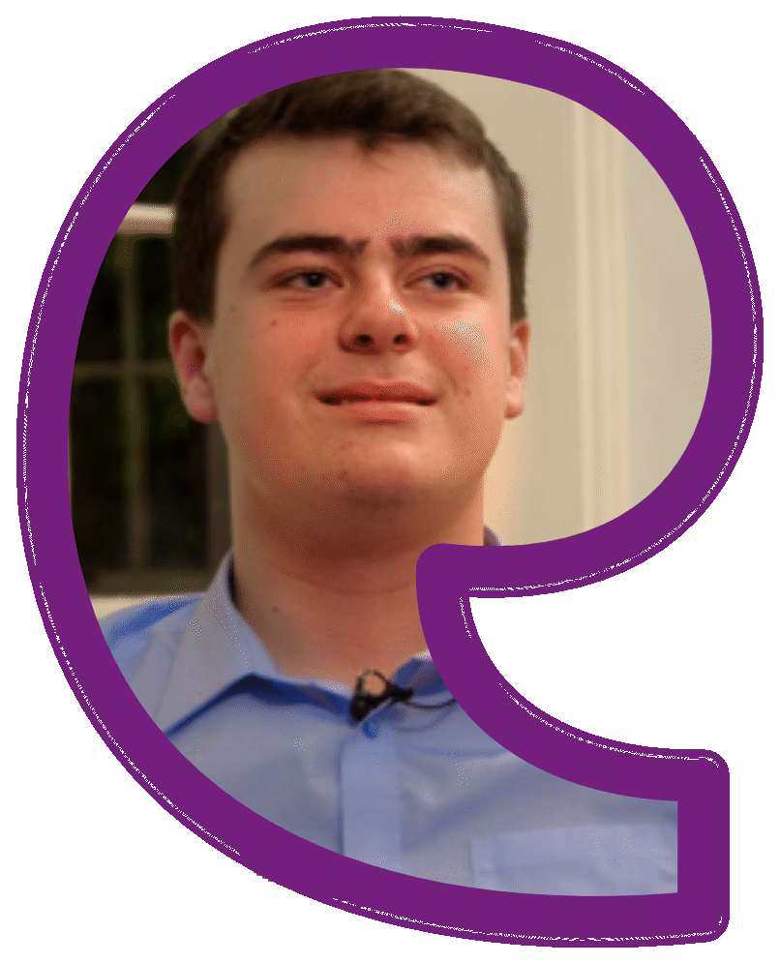

Slide 5

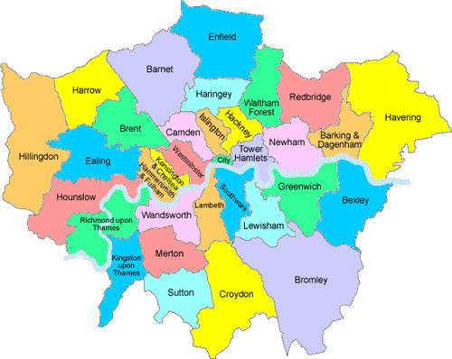

Background
Youth Out Loud! (YOL!) is a group of young people aged 13-17.
Since 2018 they work with Healthwatch in Richmond and in Kingston to use their voices and make health and care services better for young people.
We are interested in how the local health system works, we are looking to understand what children and young people think about it and improve its services.
Check our handouts to watch our launch video!

Slide 6
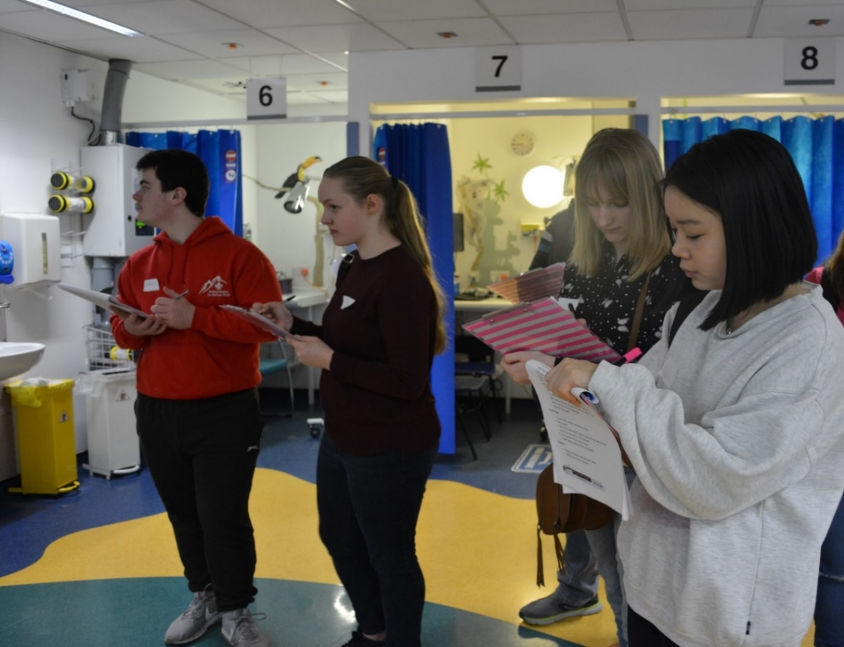
Before lockdown….
15 Steps Challenge at Kingston Hospital (Paediatric Ward and A&E)
15 Steps Challenge at Wolverton Centre (Sexual Health Centre)
Video Making
South West London Health and Care Partnership consultation on Start Well section
Signposting on yolweb.info

Slide 7
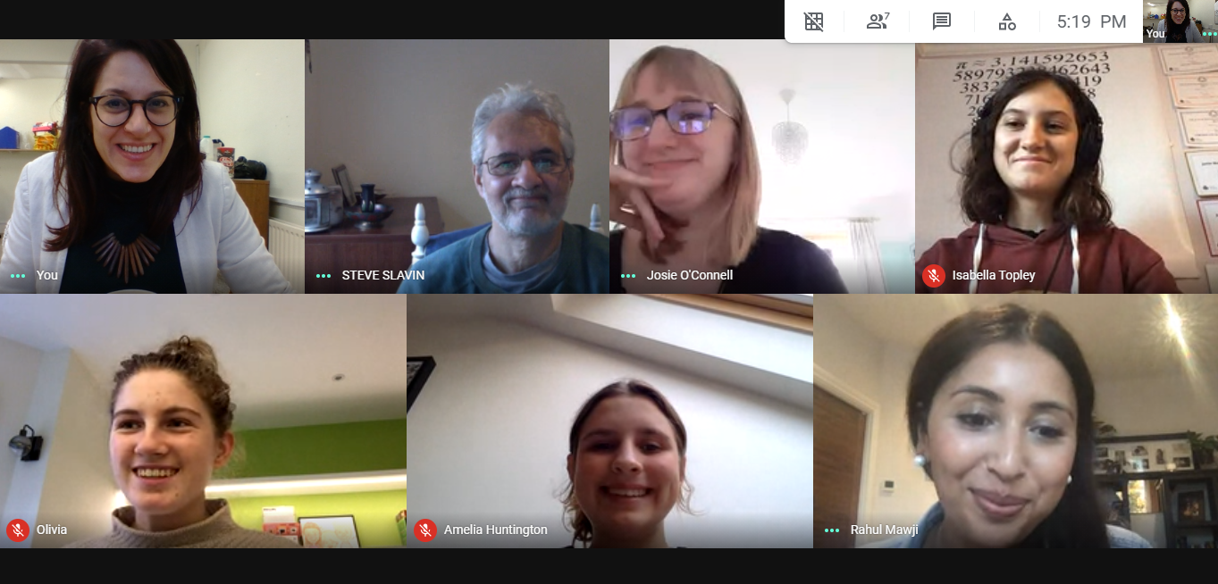
Then Coronavirus happened...
…and everything changed!

Slide 8

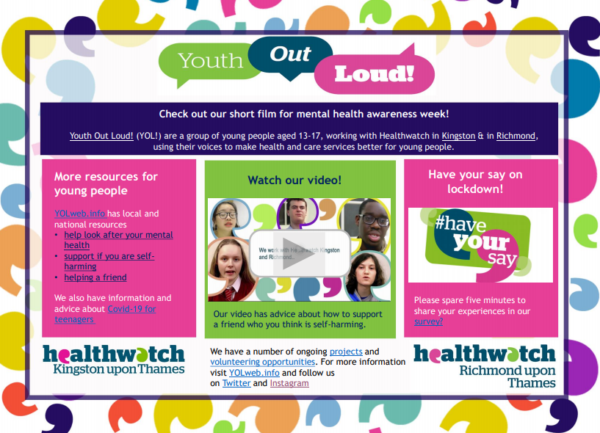
New priorities, new plans
Addressing public health priorities and signposting with an Electronic Flyer
  Mental Health Awareness Week (May)
  Sexual Health Week (September)
Stronger social media presence
Cooking Challenge
Updated yolweb.info
Survey

Slide 9
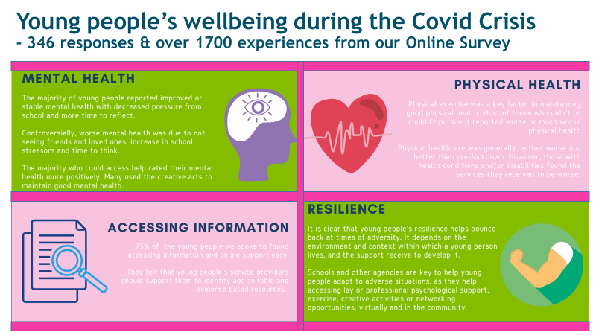

Slide 10
Key Learning
Tailoring services and support provided, dependent upon individual’s needs
Virtual vs face-to-face support
Improving young people’s wellbeing through the whole school approach
Increasing GP capacity
Cross Service Collaboration
Improving information Provision

Slide 11
Reflecting on our work
Successes | Challenges
Meeting, speaking and collecting experiences online is easy and practical | Online activities were exciting at first, then it became monotonous and less interesting (PS. no pizza!!)
Schools welcome material to support their work and their young people | Recruitment & engagement in schools, youth clubs etc. is not possible or really difficult
Some young people have more time to volunteer.. and looked for new opportunities | Some young people have a lot going on.. and disengage or are harder to reach
We have built a much stronger social media presence | We now need to maintain the social media presence and adapt to constant changes

Slide 12

Looking to the future
Empowering volunteers and valuing their amazing work is more important than ever
Creativity and lateral thinking are key!
Collaboration and (remote) networking are crucial
Being aware and updated on young people’s priorities is important
A PROPOSAL: connecting all local Healthwatch involved young people to meet regularly, share tips, tricks and information.

Slide 13



Thank you and Questions
Follow us on
(@Youth_OutLoud)
(@youth_outloud )
and visit our website www.yolweb.info

